Slide 1
Prophecy &
Encouragement

Slide 2
Wake up
LOOK UP
RISE UP

Slide 3
Romans 8 v16
The Spirit himself testifies with our spirit that we are God’s children. Now, if we are children, then we are heirs – heirs of God and co-heirs with Christ, if indeed we share in his sufferings in order that we may chare in his glory.

Slide 4
1 Corinthians 14 v 1 - 4
Follow the way of love and eagerly desire the gifts of the Spirit, especially prophecy. For anyone who speaks in a tongue does not speak to people but to God. Indeed, no one understands them, they utter mysteries by the Spirit. But the one who prophesies speaks to people for their strengthening, encouragement and comfort. Anyone who speaks in a tongue edifies themselves, but the one who prophesies edifies the church. I would like everyone of you to speak in tongues, but I would rather (have everyone one of you) prophesy.

Slide 5
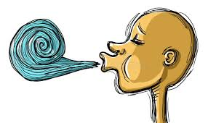

Slide 6
Qualifications required to receive the gifts of the Holy spirit & specifically prophecy
You have to be a
co-heir,
a King’s Kid!
You must follow the way of love & eagerly desire the gifts of the Spirit, especia;ly prophecy

